Slide 1


PROJECT
Penetration Testing on Webserver
By:-Sumit Paul
Rollno:-2023D2R040
Department :- BCA (Hon’S)
Model Institute of Engineering & Technology

Slide 2
What is penetration testing
Penetration testing on a web server is a controlled and authorized security assessment process that mimics real-world attacks to evaluate the security posture of a web server, its configurations, hosted web applications, and supporting infrastructure.
Steps of Penetration testing
Foot printing & Reconnaissance
Vulnerability Scanning
Exploitation
Database Access
Reporting & Remediation

Slide 3
Step 1: Foot printing & Reconnaissance
This initial phase involves collecting as much information as possible about our target.
Company Name & Details – From Google & About Us page
Website IP Address – Using nslookup we get (44.228.249.3)
Server Location – We used a website called iplocation.net
Operating System – nmap -O <target IP> or curl –I <target site>
Web Server Info – WhatWeb, Wappalyzer, or nmap -sV
Built-in Tech – PHP, MySQL (from page source, Wappalyzer)

Slide 4
Website first seen – We use web.archive.org to get the date of when the site was 1st used
ISP IP Range –We use whois <target IP> command on linux
Other domains on same server – We use yougetsignal.com to find out about other sites on the same server
Open Ports – nmap -sS -sV <target site>
Domain Registrar Info – We use whois <target IP> command on linux

Slide 5
Employee Info – Google Dorks, LinkedIn search
Company Address, CEO – Official site, LinkedIn
Firewall/Load Balancer – We use nmap -p 80,443 --script http-waf-detect testphp.vulnweb.com command on linux to check for firewalls
Directory Listing – We use command dirb http://testphp.vulnweb.com/
And found http://testphp.vulnweb.com/admin/ and http://testphp.vulnweb.com/secured/ that may contains admin panel, source codes or backend files.
Checking for files such as robots.txt, sitemap.xml – We use http://target.com/robots.txt as these files can reveal hidden or sensitive areas of the site that developers may not intend for public access.

Slide 6
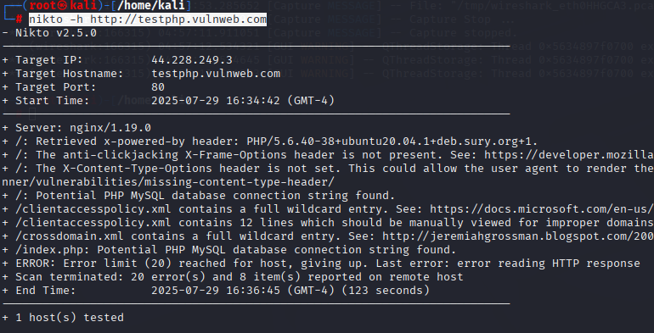
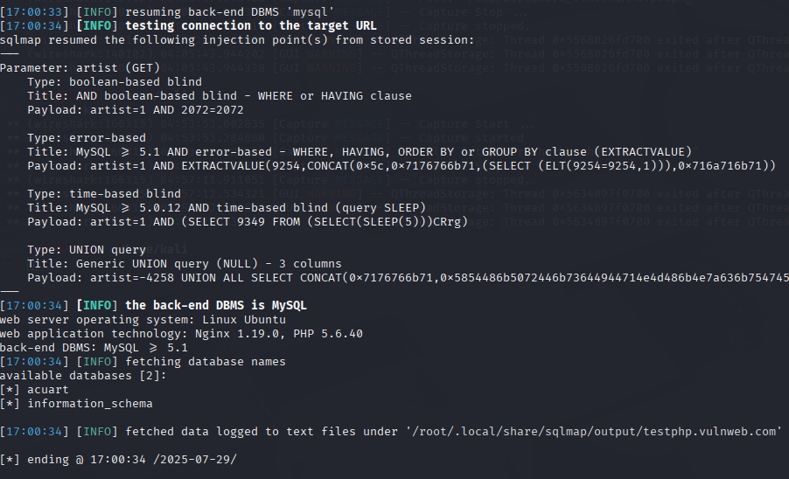
Step 2: Vulnerability Scanning
Nikto - For webserver scanning
We use nikto -h http://testphp.vulnweb.com on linux to scan the site for vulnerabilities
OUTPUT OF THIS COMMAND
X-Frame-Options header missing
X-Content-Type-Options header missing
PHP MySQL connection string exposure
clientaccesspolicy.xml with wild card entries
SQLMap – For database SQL injection
We use
sqlmap -u "http://testphp.vulnweb.com/artists.php?artist=1" –-dbs
OUTPUT OF THIS COMMAND
Target URL parameter vulnerable: artist (in Get request)
Which means the URL parameter artists is vulnerable to SQL injection

Slide 7
Step 3: Exploitation
Attacks Performed:
SQLMap to dump database: sqlmap -u "http://site.com?id=1" –dump
Hydra to brute-force FTP: hydra -l admin -P rockyou.txt ftp://IP
Manual Login Panel Attack: Using guessed/default passwords
Result:
Gained access to sample DB
Got weak login credentials (demo purposes)

Slide 8
Step 4: Final Conclusion
Findings:
Website has multiple vulnerabilities:
SQL Injection
XSS
Open Directories
Exposed Admin Panel
Recommendations:
Use a Web Application Firewall (WAF)
Sanitize all inputs to prevent SQL Injection
Disable directory listing
Remove default admin pages
Apply HTTPS with valid certificate

Slide 9


